Slide 1
TRANSITIONS, TRANSFORMS, AND
ANIMATION

Slide 2
CSS TRANSITIONS
Picture, if you will, a link in a navigation menu that changes from blue to red when the mouse hovers over it.
The background is blue…mouse passes over it…BAM! Red! It goes from state to state instantly, with no states in between.
Now imagine putting your mouse over the link and having the background gradually change from blue to red, passing through several shades of purple on the way.
It’s smoooooth. And when you remove the mouse, it fades back down to blue again.

Slide 3
CSS TRANSITIONS Cont
That’s what CSS Transitions do.
They smooth out otherwise abrupt changes to property values between two states over time by filling in the frames in between.
Animators call that tweening. When used with reserve, CSS Transitions can add sophistication and polish to your interfaces and even improve usability.

Slide 4
Transition Basics
When applying a transition, you have a few decisions to make, each of which is set with a CSS property:
Which CSS property to change (transition-property) (Required)
How long it should take (transition-duration) (Required)
The manner in which the transition accelerates (transition-timingfunction)
Whether there should be a pause before it starts (transition-delay)
Transitions require a beginning state and an end state. The element as it appears when it first loads is the beginning state.

Slide 5
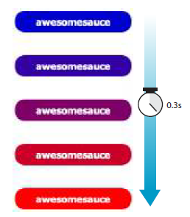
Transition Basics Cont..
THE MARKUP
<a href="…" class="smooth">awesomesauce</a>
THE STYLES
.smooth {
display: block;
text-decoration:none;
text-align: center;
padding: 1em 2em;
width: 10em;
border-radius: 1.5em;
color: #fff;
background-color: mediumblue;
transition-property: background-color;
transition-duration: 0.3s;
}
.smooth:hover, .smooth:focus {
background-color: red;
}

Slide 6
Specifying the property
transition-property
Values: property-name | all | none
Default: all
Applies to: all elements, :before and :after pseudo-elements
Inherits: no

Slide 7
How long should it take?
transition-duration
Values: time
Default: 0s
Applies to: all elements, :before and :after pseudo-elements
Inherits: no

Slide 8
Timing Functions
transition-timing-function
Values: ease | linear | ease-in | ease-out | ease-in-out | step-start | step-end | steps | cubic-bezier(#,#,#,#)
Default: ease
Applies to: all elements, :before and :after pseudo-elements
Inherits: no
If I set the transition-timing-function to ease-in-out, the transition will start out slow, then speed up, then slow down again as it comes to the end state.
    .smooth {
    …
    transition-property: background-color;
    transition-duration: 0.3s;
    transition-timing-function: ease-in-out;
    }

Slide 9
Timing Functions Cont..
The transition-timing-function property takes one of the following keyword values:
ease
Starts slowly, accelerates quickly, and then slows down at the end. This is the default value and works just fine for most short transitions.
linear
Stays consistent from the transition’s beginning to end. Because it is so consistent, some say it has a mechanical feeling.
ease-in
Starts slowly, then speeds up.
ease-out
Starts out fast, then slows down.
ease-in-out
Starts slowly, speeds up, and then slows down again at the very end. It is similar to ease, but with less pronounced acceleration in the middle.

Slide 10
Setting a Delay
transition-delay
Values: time
Default: 0s
Applies to: all elements, :before and :after pseudo-elements
Inherits: no
The transition-delay property, as you might guess, delays the start of the animation by a specified amount of time.
In the following example, the background color transition starts .2 seconds after the pointer moves over the link.
    .smooth {
    …
    transition-property: background-color;
    transition-duration: 0.3s;
    transition-timing-function: ease-in-out;
    transition-delay: 0.2s;
    }

Slide 11
The Shorthand transition Property
You’ve seen this sort of thing with the shorthand border property. Here is the syntax:
transition: property duration timing-function delay;
The values for each of the transition-* properties are listed out, separated by character spaces. The order isn’t important as long as the duration (which is required) appears before delay (which is optional).
If you provide only one time value, it will be assumed to be the duration.
Using the blue-to-red link example, we could combine the four transition properties we’ve applied so far into this one line:
      .smooth {
      …
      transition: background-color 0.3s ease-in-out 0.2s;
      }

Slide 12
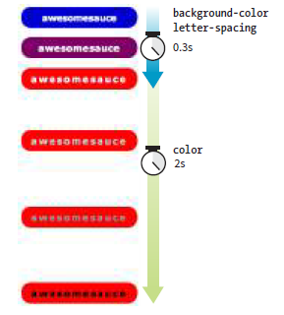
Applying Multiple Transitions
So far, we’ve changed only one property at a time, but it is possible to transition several properties at once.
Let’s go back to the “awesomesauce” link example.
This time, in addition to changing from blue to red, I’d like the letter-spacing to increase a bit.
I also want the text color to change to black, but more slowly than the other animations.

Slide 13
Applying Multiple Transitions Cont..
One way to do this is to list all of the values for each property separated by commas, as shown in this example:
    .smooth {
    …
    transition-property: background-color, color, letter-spacing;
    transition-duration: 0.3s, 2s, 0.3s;
    transition-timing-function: ease-out, ease-in, ease-out;
    }
    .smooth:hover, .smooth:focus {
    background-color: red;
    letter-spacing: 3px;
    color: black;
    }

Slide 14
Applying Multiple Transitions Cont..
You can line up values for the shorthand transition property as well.
The same set of styles we just saw could also be written as follows:
      .smooth {
      …
      transition: background-color 0.3s ease-out,
      color 2s ease-in,
      letter-spacing 0.3s ease-out;
      }

Slide 15
A Transition for All Occasions
For cases when you want the same duration, timing function, and delay to apply to all transitions that might occur on an element, use the all value for transition-property.
In the following example, I’ve specified that any property that might change for the .smooth element should last .2 seconds and animate via the ease-inout function.
    .smooth {
    …
    transition: all 0.2s ease-in-out;
    }
For user interface changes, a short, subtle transition is often all you need for all your transitions, so the all value will come in handy.

Slide 16
CSS TRANSFORMS
transform
Values: rotate() | rotateX() | rotateY() | rotateZ() | rotate3d() |translate() | translateX() | translateY() | scale() | scaleX() | scaleY() | skew() | skewX() | skewY() | none
Default: none
Applies to: transformable elements (see sidebar)
Inherits: no

Slide 17
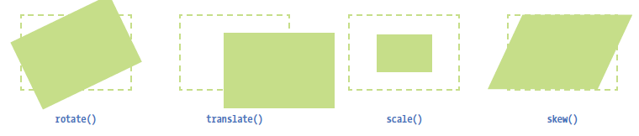
CSS TRANSFORMS Cont..
a representation of four two-dimensional transform functions:
rotate(), translate(), scale(), and skew() (see Note).
The dashed outline shows the element’s original position.

Slide 18

Transforming the Angle (rotate)
The image in FIGURE has been rotated –10 degrees (350 degrees) with the following style rule.
The tinted image shows the element’s original position for reference.
  img {
  width: 400px;
  height: 300px;
  transform: rotate(-10deg);
  }

Slide 19

Transforming the Angle (rotate)
transform-origin
Values: percentage | length | left | center | right | top | bottom
Default: 50% 50%
Applies to: transformable elements
Inherits: no

Slide 20
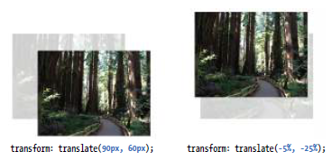
Transforming the Position (translate)
Another thing you can do with the transform property is give the element’s rendering a new location on the page by using one of three translate() functions, as shown in the examples in FIGURE.
The translateX() function allows you to move an element on a horizontal axis; translateY() is for moving along the vertical axis; and translate() combines both x and y values.
transform: translateX(50px);
transform: translateY(25px);
transform: translate(50px, 25px); /* (translateX, translateY) */

Slide 21
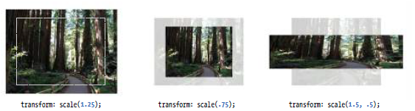
Transforming the Size (scale)
Make an element appear larger or smaller by using one of three scale functions:
scaleX() (horizontal), scaleY() (vertical), and the shorthand scale().
The value is a unitless number that specifies a size ratio. This example makes an image 150% its original width:
    a img {
    transform: scaleX(1.5);
    }
The scale() shorthand lists a value for scaleX and a value for scaleY.
This example makes an element twice as wide but half as tall as the original:
    a img {
    transform: scale(2, .5);
    }

Slide 22
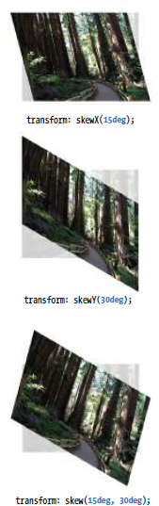
Making It Slanty (skew)
The quirky collection of skew properties—skewX(), skewY(), and the shorthand skew()—changes the angle of either the horizontal or vertical axis (or both axes) by a specified number of degrees. As for translate(), if you provide only one value, it is used for skewX(), and skewY() will be set to zero.
The best way to get an idea of how skewing works is to take a look at some
examples (FIGURE):
  a img {
  transform: skewX(15deg);
  }
  a img {
  transform: skewY(30deg);
  }
  a img {
  transform: skew(15deg, 30deg);
  }

Slide 23
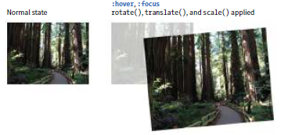
Applying Multiple Transforms
It is possible to apply more than one transform to a single element by listing out the functions and their values, separated by spaces, like this:
transform: function(value) function(value);
In the example in FIGURE, I’ve made the forest image get larger, tilt a little, and move down and to the right when the mouse is over it or when it is in focus:
    img:hover, img:focus {
    transform: scale(1.5) rotate(-5deg) translate(50px,30px);
    }

Slide 24

KEYFRAME ANIMATION
The CSS Animations Module allows authors to create real, honest-to-goodness keyframe animation.
FIGURE shows just a few examples that you can see in action online. Unlike transitions that go from a beginning state to an end state, keyframe animation allows you to explicitly specify other states at points along the way, allowing for more granular control of the action.
Those “points along the way” are established by keyframes that define the beginning or end of a segment of animation.

Slide 25
Establishing the Keyframes
The animation process has two parts:
1. Establish the keyframes with a @keyframes rule.
2. Add the animation properties to the elements that will be animated.
Here is a very simple set of keyframes that changes the background color of an element over time.
It’s not a very action-packed animation, but it should give you a basic understanding of what a @keyframes rule does.
      @keyframes colors {
      0% { background-color: red; }
      20% { background-color: orange; }
      40% { background-color: yellow; }
      60% { background-color: green; }
      80% { background-color: blue; }
      100% { background-color: purple; }
      }

Slide 26
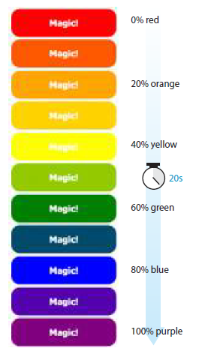
Establishing the Keyframes Cont..
The keyframes at-rule identifies the name of the animation, the stages of the animation represented by percentage (%) values, and the CSS properties that are affected for each stage. Here’s what a @keyframes rule looks like abstracted
down to its syntax:
@keyframes animation-name {
keyframe { property: value; }
/* additional keyframes */
}
The sample @keyframes rule says: create an animation sequence called “colors.”
At the beginning of the animation, the background-color of the element
should be red; at 20% through the animation runtime, the background color
should be orange; and so on, until it reaches the end of the animation.
The browser fills in all the shades of color in between each keyframe (or tweens it,
to use the lingo). This is represented the best I could in FIGURE.

Slide 27
Establishing the Keyframes Cont..
As an alternative to percentages, you can use the keyword from for the start of an animation sequence (equivalent to 0%) and the keyword to for denoting the end (100%).
The following example makes an element slide in from right to left as the left margin reduces to 0:
      @keyframe slide {
      from { margin-left: 100% }
      to { margin-left: 0%; }
      }

Slide 28
Adding Animation Properties
Now we can apply this animation sequence to an element or multiple elements in the document by using a collection of animation properties that are very similar to the set of transition properties that you already know.
I am going to apply the rainbow animation to the #magic div in my document:
<div id="magic">Magic!</div>
In the CSS rule for #magic, I make decisions about the animation I want to apply:
    Which animation to use (animation-name) (Required).
    How long it should take (animation-duration) (Required).
    The manner in which it should accelerate (animation-timing-function).
This property uses the same timing function keywords that we covered for CSS Transitions.
    Whether to pause before it starts (animation-delay).

Slide 29
Adding Animation Properties Cont..
There are a few other animation-specific properties to know about as well:
animation-iteration-count
How many times the animation should repeat. This can be set to a whole number or infinite.
animation-direction
Whether the animation plays forward (normal), in reverse (reverse), or alternates back and forth starting at the beginning (alternate), or alternates starting from the end (alternate-reverse).
animation-fill-mode
The animation fill mode determines what happens with the animation before it begins and after it ends. By default (none), the animation shows whatever property values were not specified via @keyframes.
If you want the last keyframe to stay visible after the animation plays, use the forwards keyword.
If there is a delay set on the animation and you want the first keyframe to show during that delay, use backwards. To retain the beginning and end states, use both.
animation-play-state
Whether the animation should be running or paused when it loads. The play-state can be toggled on and off based on user input with JavaScript or on hover.

Slide 30
Adding Animation Properties Cont..
Here is the resulting rule for the animated div:
    #magic {
    …
    animation-name: colors;
    animation-duration: 5s;
    animation-timing-function: linear;
    animation-iteration-count: infinite;
    animation-direction: alternate;
    }
You can also use the animation shorthand property to combine the values, just as we did for transition:
    #magic {
    animation: colors 5s linear infinite alternate;
    }

